Slide 1
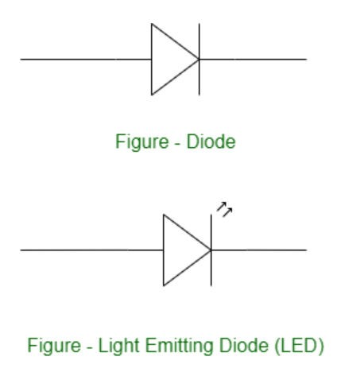
Programming and connection: Blinking LED & Fading LED
LEDs (Light Emitting Diodes) are becoming increasingly popular among a wide range of people. When a voltage is given to a PN Junction Diode, electrons, and holes recombine in the PN Junction and release energy in the form of light (Photons). An LED’s electrical sign is comparable to that of a PN Junction Diode. When free electrons in the conduction band recombine with holes in the valence band in forward bias, energy is released in the form of light.

Slide 2
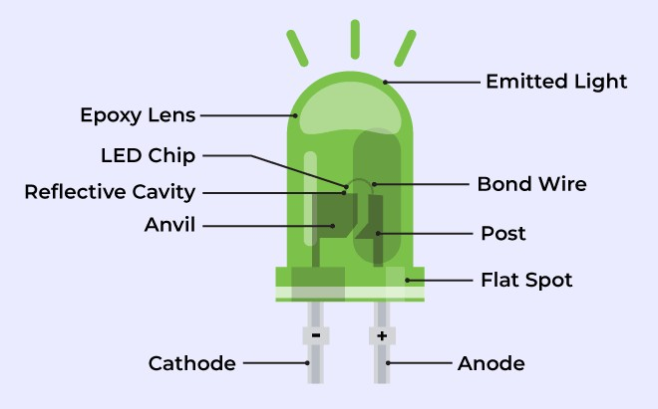
Structure of an LED
The flow of charge carriers (electrons and holes) across the P-N junction drives the activity of an LED. When a forward voltage (anode positive in comparison to the cathode) is applied, electrons and holes recombine at the junction, releasing energy in the form of photons (light).

Slide 3
The semiconductor chip is linked to external terminals known as the anode (+) and the cathode (-). The anode is linked to the P-region, and the cathode to the N-region.
Fading an LED
Fading LED refers to the gradual change in brightness of an LED light over a certain period of
time. This project demonstrates the use of the analogWrite() function in fading an LED off. AnalogWrite uses pulse width modulation (PWM). Fading LED can be achieved by controlling the amount of time the LED is on and off over a specific period. Pulse Width Modulation (PWM) is a technique used to control the brightness of an LED by rapidly switching it on and off at a specific frequency to create a fading effect. The duty cycle of the PWM signal determines the brightness of the LED, where a duty cycle of 100% means the LED is fully on, and a duty cycle of 0% means the LED is fully off. By adjusting the duty cycle, we can achieve the desired brightness of the LED.

Slide 4
Components Required
You will need the following components −
1 × Breadboard
1 × Arduino Uno R3
1 × LED
1 × 330Ω Resistor
2 × Jumper

Slide 5
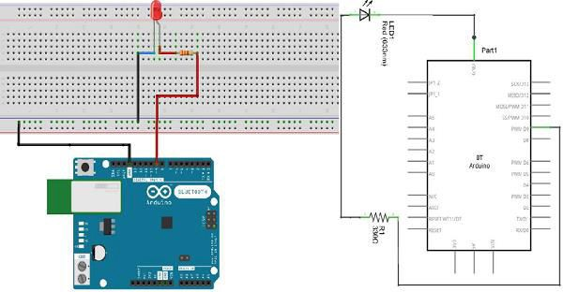
Working Procedure
Follow the circuit diagram and hook up the components on the breadboard as shown in the image given below.

Slide 6
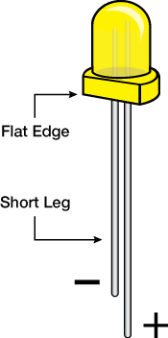
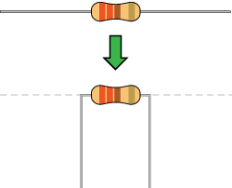
Note − To find out the polarity of an LED, look at it closely. The shorter of the two legs, towards the flat edge of the bulb indicates the negative terminal.
Components like resistors need to have their terminals bent into 90° angles in order to fit the breadboard sockets properly. You can also cut the terminals shorter.

Slide 7

Sketch
Open the Arduino IDE software on your computer. Coding in the Arduino language will control your circuit. Open the new sketch File by clicking New.

Slide 8
Arduino Code
/*Fade
This example shows how to fade an LED on pin 9 using the analogWrite() function. The analogWrite() function uses PWM, so if you want to change the pin you're using, be sure to use another PWM capable pin. On most Arduino, the PWM pins are identified with a "~" sign, like ~3, ~5, ~6, ~9, ~10 and ~11.
*/
int led = 9; // the PWM pin the LED is attached to
int brightness = 0; // how bright the LED is
int fadeAmount = 5; // how many points to fade the LED by the setup routine runs once when you press reset
void setup() {
// declare pin 9 to be an output
pinMode(led, OUTPUT);
}
// the loop routine runs over and over again forever

Slide 9
void loop() {
// set the brightness of pin 9
analogWrite(led, brightness);
// change the brightness for next time through the loop
brightness = brightness + fadeAmount;
// reverse the direction of the fading at the ends of the fade
if (brightness == 0 || brightness == 255) {
fadeAmount = -fadeAmount ;
}
// wait for 30 milliseconds to see the dimming effect
delay(300);
}

Slide 10
Code to Note
After declaring pin 9 as your LED pin, there is nothing to do in the setup() function of your code. The analogWrite() function that you will be using in the main loop of your code requires two arguments: One, telling the function which pin to write to and the other indicating what PWM value to write.
In order to fade the LED off and on, gradually increase the PWM values from 0 (all the way off) to 255 (all the way on), and then back to 0, to complete the cycle. In the sketch given above, the PWM value is set using a variable called brightness. Each time through the loop, it increases by the value of the variable fadeAmount.
If brightness is at either extreme of its value (either 0 or 255), then fadeAmount is changed to its negative. In other words, if fadeAmount is 5, then it is set to -5. If it is -5, then it is set to 5. The next time through the loop, this change causes brightness to change direction as well. analogWrite() can change the PWM value very fast, so the delay at the end of the sketch controls the speed of the fade. Try changing the value of the delay and see how it changes the fading effect.

Slide 11
Result
You should see your LED brightness change gradually.

